Slide 1
Comparison of Methods for Capturing Material Discontinuities
With an Introduction to GPU Programming
Sean Davis and Will Matern

Slide 2
Acknowledgements
Mentor: Dr. Bob Robey
Workshop Coordinator: Dr. Scott Runnels
Collaborator: David Nicholaeff
Thank you!

Slide 3
Outline
Motivation
Problems with capturing discontinuities
Methods implemented and tested
First order Upwind
Lax-Wendroff with limiters
MUSCL
SUPG
Early MPDATA results
GPU Programming
Introduction
Results solving the shallow water equations
Conclusions

Slide 4
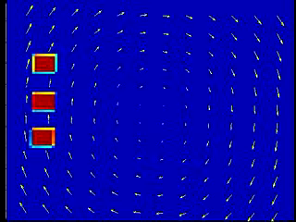
Motivation
A simple model problem showing the advection of radioactive water dumped into the ocean and carried by a rotational current across the Pacific.

Slide 5
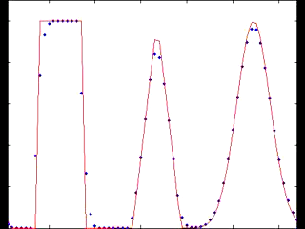
First Order Upwind Scheme
Conservative 1st order scheme
Overly dissipative

Slide 6
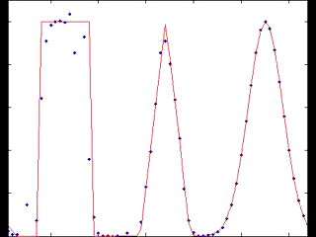
Lax-Wendroff w/o Limiters
Conservative 2nd order scheme
Approximate solution has oscillations around sharp gradients

Slide 7
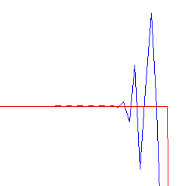
Limiters
Godunov’s Theorem – Any linear scheme above first order accurate (space) cannot be Total Variation Diminishing (TVD).
Solution: Limiters (a nonlinear scheme)
Exact Solution
Non-TVD Solution
Notes:
First order at discontinuities
Doesn’t affect the solution when it is smooth
Discuss TVD

Slide 8
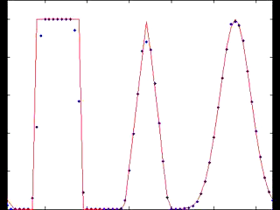
Lax-Wendroff w/ Superbee Limiter
1st order near discontinuities, 2nd order elsewhere
For linear equations is mathematically guaranteed to be TVD

Slide 9
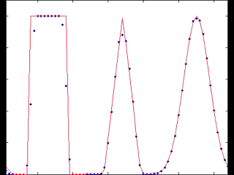
Monotone Upstream Scheme for Conservation Laws (MUSCL)
Used a modified Osher-Chakravarthy scheme
Second order TVD approximation
Upwind biased
Numerical oscillations avoided using a minmod function

Slide 10
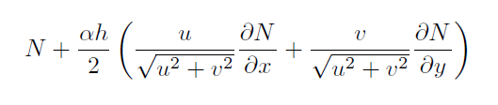
Streamline Upwind Petrov-Galerkin (SUPG)
Trial functions – a set of functions assumed to approximate the underlying solution. The trial functions have degrees of freedom that must be solved for.
Test functions – a set of functions used to solve for the degrees of freedom of the trial functions. Uses the weak formulation of the governing equation.
Petrov-Galerkin – Test functions ≠ Trial functions
SUPG – Choose test functions to be:
where N is a trial function

Slide 11
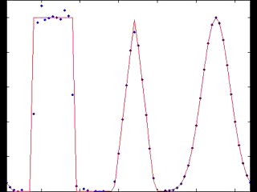
SUPG
Finite Element approach
Inspired by finite difference methods (upwinding and artificial diffusion)
Applies to linear advection/diffusion equations of any dimension
Is neither TVD nor conservative

Slide 12
Wave Advection Test Conclusions
Lax-Wendroff with slope limiters
Effective for sharp discontinuities
Overly dissipative for thin waves (cuts off the top of the triangular/gaussian waves)
more dissipative than other methods
Superbee limiter artificially sharpens smooth waves
MUSCL with ACM
most effective for problems with discontinuities
Unnaturally sharpens the solution
SUPG
Balances well between diffusion and discontinuity sharpness
Doesn’t introduce unnatural sharpening
Requires matrix operations
Non-conservative

Slide 13
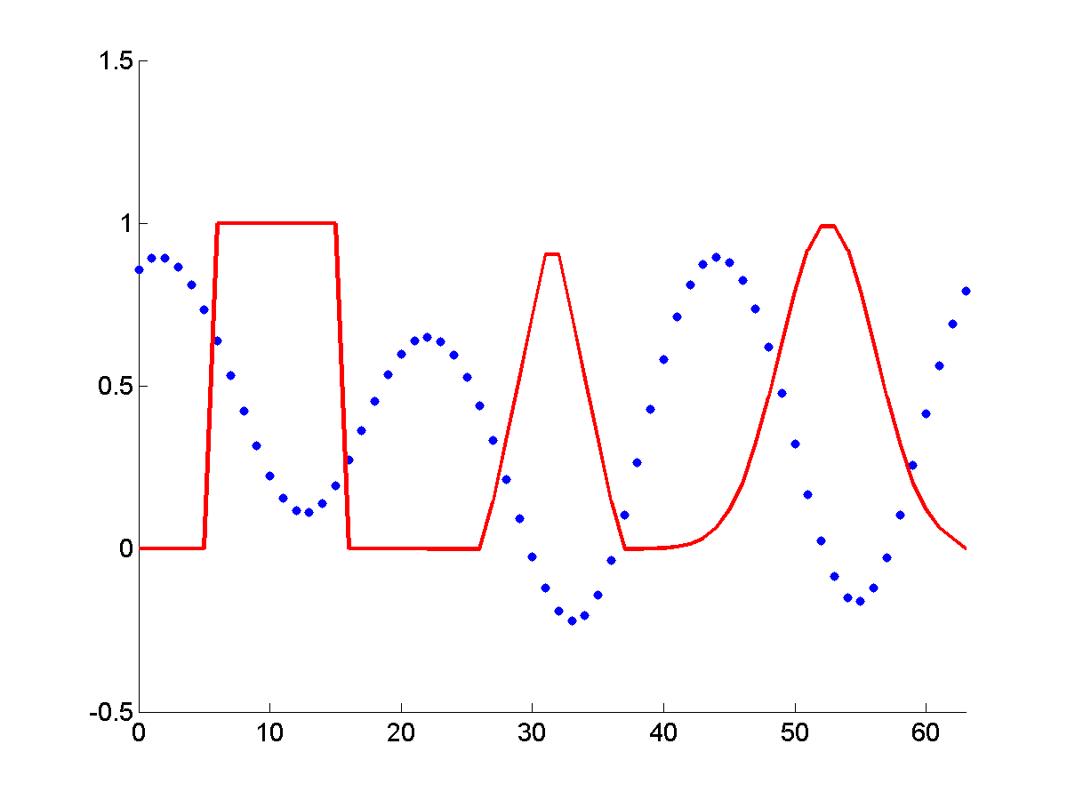
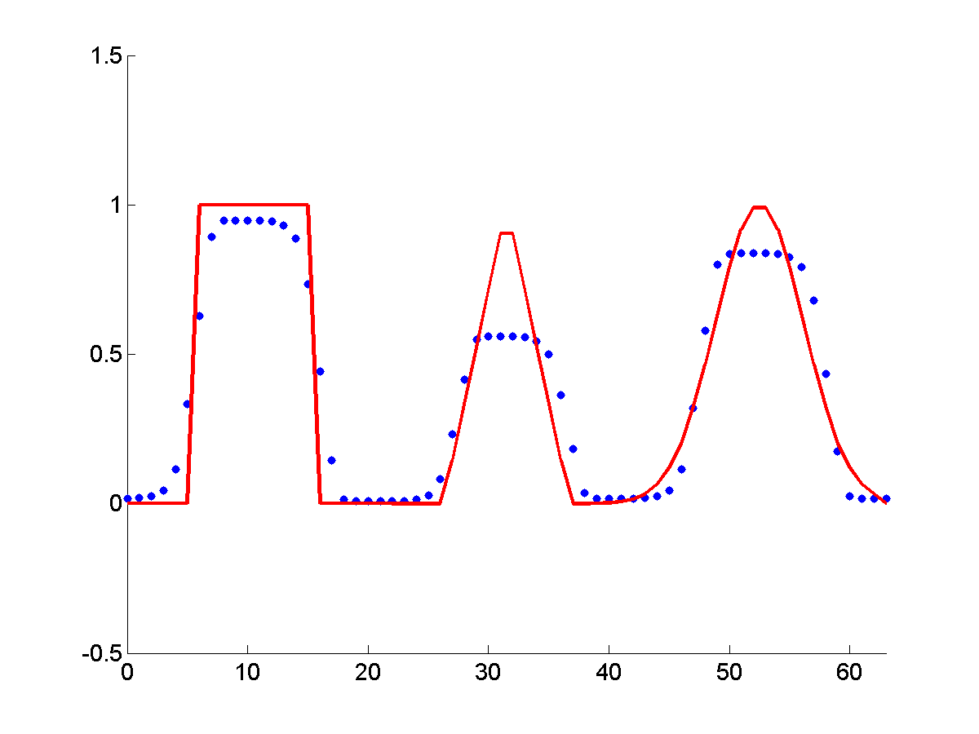
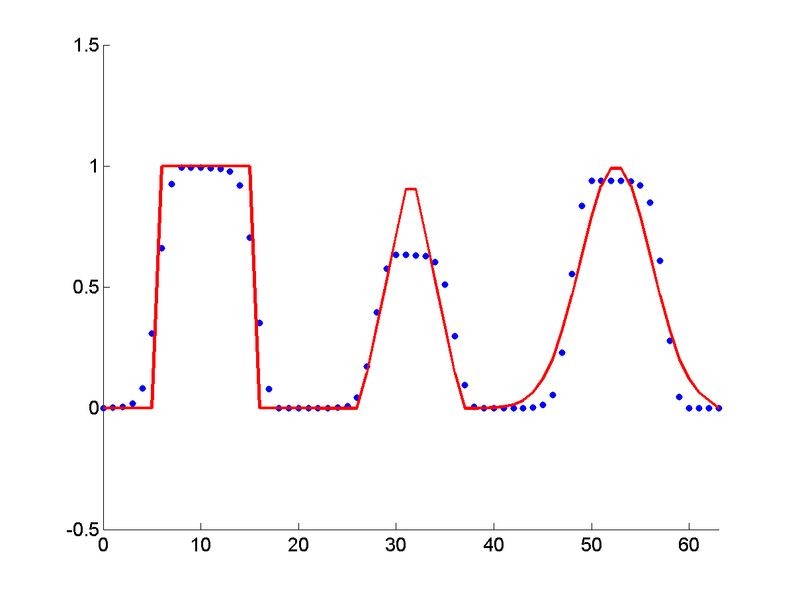
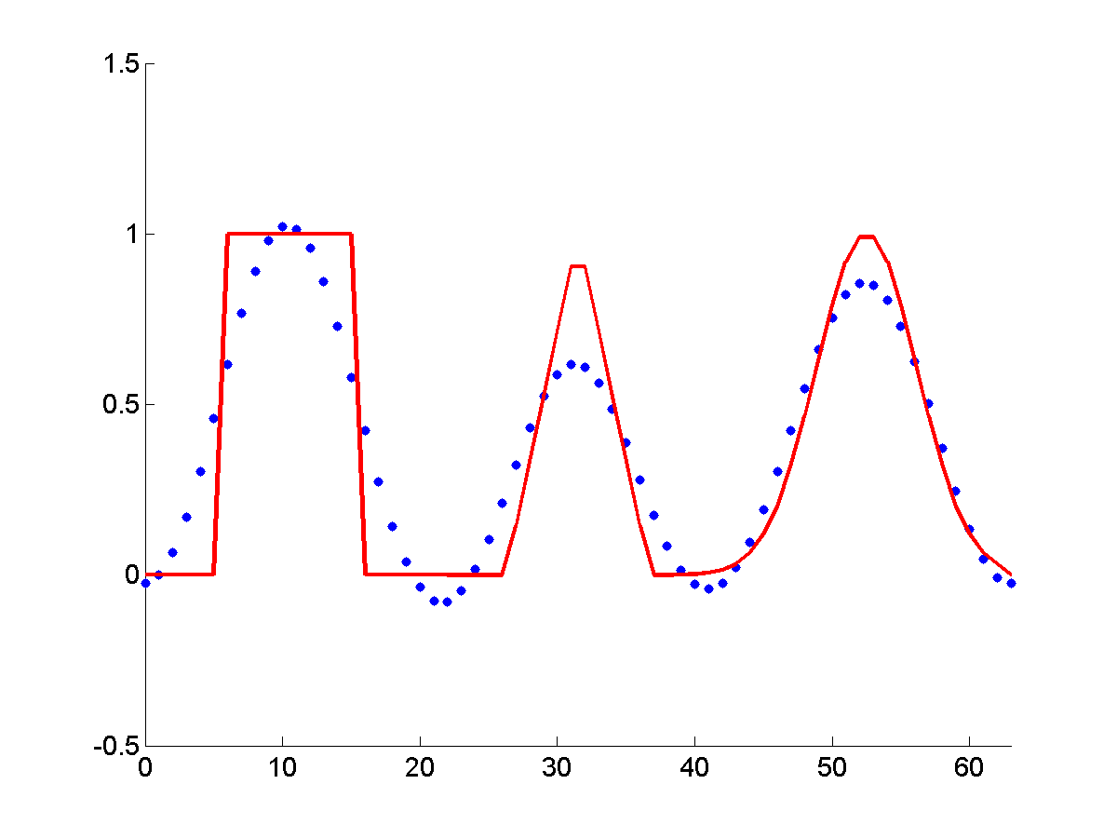
Results for 1D Advection in a 2D Code after 10 Periods
Lax-Wendroff (not TVD):
Lax-Wendroff (Superbee):
MUSCL:
SUPG:
Notes:
Only show the last column.

Slide 14
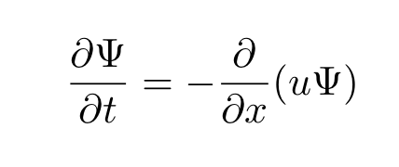
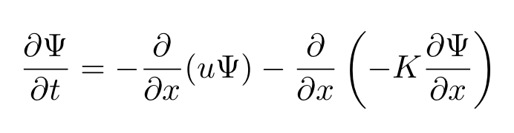
Multidimensional Positive Definite Advection Transport Algorithm (MPDATA)
A donor-cell approximation is defined in terms of the local Courant number
Adds a diffusive convective flux
Subtract out added dissipation using an antidiffusive velocity
As an example, the 1D advection equation,
becomes,
Notes:
Using a modified equation analysis.

Slide 15
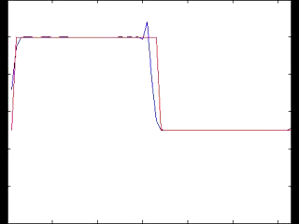
MPDATA
Antidiffusive correction to the donor cell method causes oscillations
PRELIMINARY

Slide 16
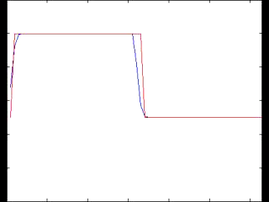
MPDATA
A Flux Corrected Transport (FCT) algorithm can correct the oscillations
Performing additional local corrective iterations increases the order of accuracy of the solution
PRELIMINARY

Slide 17
GPUs at a glance
Different architecture from a CPU.
Many low throughput processing units
Cores all share memory
Workgroups
Higher FLOPS (floating points operations per second) per dollar than CPUs.
Must use a language compiled for GPU
OpenCL – Open programming language that can make use of multiple CPUs (on the same node) and a GPU. Can combine with MPI for multiple nodes.
CUDA – Nvidia only.

Slide 18
GPU architecture
Global Memory
Available to entire device
Local Memory
Available to the work group only
***I think this isn’t well defined in OpenCL and can spill over to Global without warning
Private Memory
Available to work item only
Constant Memory
Read only, can be faster than global
SIMD group size – efficient code is a multiple of this
Nvidia – Warp size is 32
ATI – Workgroup size is 64
http://stackoverflow.com/questions/7093488/opencl-how-to-i-query-for-a-devices-simd-width

Slide 19
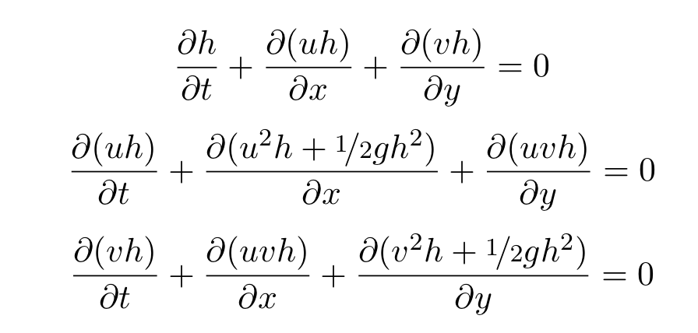
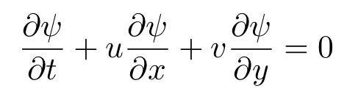
Shallow Water Equations
Simplification of the Euler Equations
Uniform Fluid Density
Wavelengths are much longer than fluid depth
Inert Tracer Equation
Notes:
Talk about the simplifications and that the tracer equation is simply an advection equation.

Slide 20
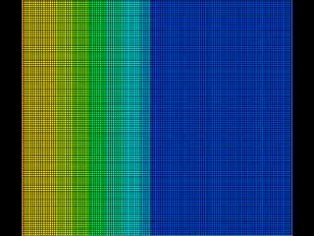
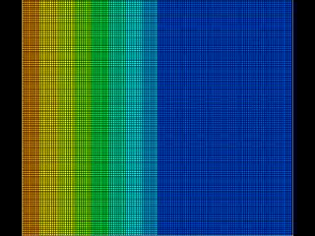
Shallow Water Simulations on the GPU
Fluid Height
Inert Tracer Concentration

Slide 21
Future Directions
FEM approach for full Euler equations
Implement more of these schemes in the GPU code
Develop full Euler Equation solvers with some of these schemes
Alternative numerical methods (WENO, Discontinuous Galerkin, etc.)

Slide 22
Question, Comments, Suggestions?

